Slide 1
Operators
Faheem Ahmed

Slide 2
Introduction
An operator specifies the type of operation to be performed on the values of variables and expressions.
JavaScript provides different types of operators to perform simple to complex calculations and evaluations.
Certain operators are also used to construct relational and logical statements. These statements allow implementing decision and looping constructs.

Slide 3
Basics of Operators 1-2
An operation is an action performed on one or more values stored in variables.
The specified action either changes the value of the variable or generates a new value.
An operation requires minimum one symbol and some value.
Symbol is called an operator and it specifies the type of action to be performed on the value.
Value or variable on which the operation is performed is called an operand.

Slide 4
Basics of Operators 2-2
Three main types of operators are as follows:
Unary operators - Operates on a single operand.
Binary operators - Operates on two operands.
Ternary operators - Operates on three operands.

Slide 5
Operators and their Types
Operators help in simplifying expressions.
JavaScript provides a predefined set of operators that allow performing different operations.
JavaScript operators are classified into six categories based on the type of action they perform on operands.
Six categories of operators are as follows:
^{Arithmetic operators}
^{Relational operators}
^{Logical operators}
^{Assignment operators}
^{Bitwise operators}
^{Special operators}

Slide 6
Arithmetic Operators 1-2
Are binary operators.
Perform basic arithmetic operations on two operands.
Operator appears in between the two operands, which allow you to perform computations on numeric and string values.
Following table lists arithmetic operators.
^{Arithmetic Operator} | ^{Description} | ^{Example}
^{+ (Addition)} | Performs addition. In case of string values, it behaves as a string concatenation operator and appends a string at the end of the other | ⁴⁵ ⁺ ⁵⁶
^{- (Subtraction)} | Performs subtraction. If a larger value is subtracted from a smaller value, it returns a negative numeric value | ⁷⁶⁻⁷⁸
^{/ (Division)} | Divides the first operand by the second operand and returns the quotient | ^{24 / 8}
^{% (Modulo)} | Divides the first operand by the second operand and returns the remainder | ^{90 % 20}
^{* (Multiplication)} | ^{Multiplies the two operands} | ^{98 * 10}

Slide 7
Relational Operators 1-3
Are binary operators that make a comparison between two operands.
After making a comparison, they return a boolean value namely, true or false.
Expression consisting of a relational operator is called as the relational expression or conditional expression.
Following table lists the relational operators.
^{Relational Operators} | ^{Description} | ^{Example}
^{== (Equal)} | Verifies whether the two operands are equal | ⁹⁰ ⁼⁼ ⁹¹
^{!= (Not Equal)} | Verifies whether the two operands are unequal | ^{99 != 98}
^{=== (Strict Equal)} | Verifies whether the two operands are equal and are of the same type | ^{numTwo = 1}
^{!== (Strict Not Equal)} | Verifies whether the two operands are unequal and whether are not of the same type | ^{90 % 20}

Slide 8
Relational Operators 2-3
Following table lists some more relational operators.
^{Relational Operators} | ^{Description} | ^{Example}
^{> (Greater Than)} | Verifies whether the left operand is greater than the right operand | ^{97 > 95}
^{< (Less Than)} | Verifies whether the left operand is less than the right operand | ^{94 < 96}
^{>= (Greater Than or Equal)} | Verifies whether the left operand is greater than or equal to the right operand | ^{92 >= 93}
^{<= (Less Than or Equal)} | Verifies whether the left operand is less than or equal to the right operand | ^{99 <= 100}

Slide 9
Logical Operators 1-2
Are binary operators that perform logical operations on two operands.
They belong to the category of relational operators, as they return a boolean value.
Following table lists the logical operators.
^{Logical Operators} | ^{Description} | ^{Example}
^{&& (AND)} | Returns true, if either of the operands are evaluated to true. If first operand evaluates to true, it will ignore the second operand | ^{(x == 2) &&} ^{(y == 5)} ^{Returns false}
^{! (NOT)} | Returns false, if the expression is true and vice-versa | ^{!(x == 3)} ^{Returns true}
^{|| (OR)} | Returns true, if either of the operands are evaluated to true. If first operand evaluates to true, it will ignore the second operand | ^{(x == 2) || (y == 5)} ^{Returns true}

Slide 10
Assignment Operators
Assignment operators assign the value of the right side operand to the operand on the left side by using the equal to operator (=).
Simple assignment operator - Is the ‘=’ operator which is used to assign a value or result of an expression to a variable.
Compound assignment operator - Is formed by combining the simple assignment operator with the arithmetic operators.
Following table lists the assignment operators.
^{Expressions} | ^{Description} | ^{Example}
^{numOne += 6;} | ^{numOne = numOne + 6} | ^{numOne = 12}
^{numOne -= 6;} | ^{numOne = numOne – 6} | ^{numOne = 0}
^{numOne *= 6;} | ^{numOne = numOne * 6} | ^{numOne = 36}
^{numOne %= 6;} | ^{numOne = numOne % 6} | ^{numOne = 0}
^{numOne /= 6;} | ^{numOne = numOne / 6} | ^{numOne = 1}

Slide 11
Bitwise Operators 1-2
Represent their operands in bits (zeros and ones) and perform operations on them.
They return standard decimal values.
Compound assignment operator - Is formed by combining the simple assignment operator with the arithmetic operators.

Slide 12
Bitwise Operators 2-2
Following table lists the bitwise operators in JavaScript.
^{Bitwise Operators} | ^{Description} | ^{Example}
^{& (Bitwise AND)} | Compares two bits and returns 1 if both of them are 1 or else returns 0 | ⁰⁰¹¹¹⁰⁰⁰ ^{Returns 00011000}
^{~ (Bitwise NOT)} | Inverts every bits of the operand and is a unary operator | ^{~00010101} ^{Returns 11101010}
^{| (Bitwise OR)} | Compares two bits and returns 1 if the corresponding bits of either or both the operands is 1 | ⁰⁰¹¹¹⁰⁰⁰ ^{Returns 00111100}
The Code Snippet demonstrates the use of bitwise operators.
//(56 = 00111000 and 28 = 00011100)
alert(“56” + ‘ & ‘ + “28” + ‘ = ‘ + (56 & 28));
//(56 = 00111000 and 28 = 00011100)
alert(“56” + ‘ | ‘ + “28” + ‘ = ‘ + (56 | 28));

Slide 13
Special Operators 1-2
There are some operators in JavaScript which do not belong to any of the categories of JavaScript operators.
Such operators are referred to as the special operators.
Following table lists the special operators in JavaScript.
^{Special Operators} | ^{Description}
^{, (comma)} | Combines multiple expressions into a single expression, operates on them in the left to right order and returns the value of the expression on the right.
^{?: (conditional)} | Operates on three operands where the result depends on a condition. It is also called as ternary operator and has the form condition, ? value1:value2. If the condition is true, the operator obtains value1 or else obtains value2.
^{typeof} | Returns a string that indicates the type of the operand. The operand can be a string, variable, keyword, or an object.

Slide 14
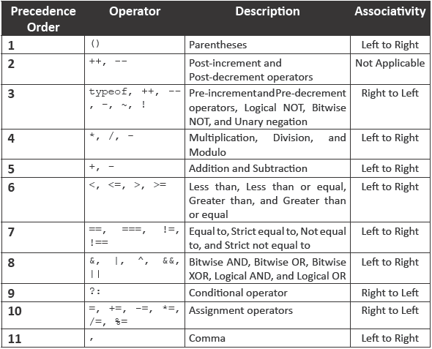
Operator Precedence
Following table lists the precedence of the operators from the highest to the lowest and their associativity.

Slide 15

JavaScript Operators
JavaScript Arithmetic Operators
Arithmetic operators are used to perform arithmetic on numbers (literals or variables).
Operator | Description
+ | Addition
- | Subtraction
* | Multiplication
/ | Division
% | Modulus
++ | Increment
-- | Decrement

Slide 16
JavaScript Assignment Operators
Assignment operators assign values to JavaScript variables
.
The assignment operator (=) assigns a value to a variable.
Operator | Example | Same As
= | x = y | x = y
+= | x += y | x = x + y
-= | x -= y | x = x - y
*= | x *= y | x = x * y
/= | x /= y | x = x / y
%= | x %= y | x = x % y

Slide 17
JavaScript Comparison and Logical Operators
Operator | Description
== | equal to
=== | equal value and equal type
!= | not equal
!== | not equal value or not equal type
> | greater than
< | less than
>= | greater than or equal to
<= | less than or equal to

Slide 18
Addition program
Take two integers as input from the user
Perform the addition
Display the result
Output
Since a prompt dialog returns the value typed by the user to the program as a string, use function parseInt to convert the string arguments to an integer.
For this program, if user enters a non-integer value or clicks Cancel then sum will appear as NaN (Not a number).

